Slide 1

Resources

Slide 2
Resource Mobilization
Social movements depend on resources
Emergence, activity, and persistence

Slide 3
Questions about Resources
What?
What are the various types of resources important for social movements?
Where/Who?
From where do these resources flow?
Strings attached?: Does the source of the resource affect movement goals and activities?

Slide 4
Resources
Resources vary by type:
Anything movements can use to advance their interests
People
Money
Legitimacy
Notes:
Legitimacy amongst relevant actors such as the movement’s constituency, public, policymakers

Slide 5
Resources
Resources vary by fungibility:
Usability in other contexts or convertibility into other resources
Money is highly fungible
Legitimacy is not fungible
Notes:
Money can be used for various items, can be transferred to other contexts, and can be used to get other resources (hiring people, office space, equipment).

Slide 6
Resource Types
Material
Human
Social-Organizational
Moral
Cultural

Slide 7
Typology of Resources
General Resources | Subtypes | Examples | Fungible
Material | Money | Cash donations | Yes
 | Supplies | Paper, telephones | No
 | Physical Space | Meeting/office space | No
 | Transportation | Cars, vans, pickups | Partially
 | Employment | Jobs for activists | Partially
Human | Generalized Labor | Envelope stuffers, marchers, picketers | Partially
 | Specialized Labor | Computer experts, legal council | Partially
 | Leadership | Organizational and inspirational | Partially
Social-Organizational | Infrastructures | Sidewalks, streets, postal service | Yes
 | Social Networks | Ties to other individuals and organizations | Partially
 | Formal Organizations |  | Partially
Moral | Legitimacy | Positive public opinion | Partially
 | Solidarity | Joining in the cause | Partially
 | Celebrity | Celebrity endorsements | Partially
Cultural | Repertoires | Organizational, tactical, and technical strategies | No
 | Literature, media, film, internet | Using these forms to frame SMO interests | No
Notes:
Certain religious organizations seek endorsements from celebrities

Slide 8
So you want to build a movement?
What are your ideal resources? Which 3-5 would you choose and why?
How would you use those resources?
How would you generate those resources?

Slide 9
Resource Derivation
Resources vary by source:
External
Conscious non-movement constituents
Individuals, groups, or organizations who support movement activity without benefitting directly from the movement’s goal attainment
Internal
Indigenous movement constituents
Movement members who could benefit from goal attainment
Both

Slide 10
Derivation Depends on Movement Type
Homeless SMOs
More external since impoverished
Other SMOs
Less external/more indigenous, more mixed

Slide 11
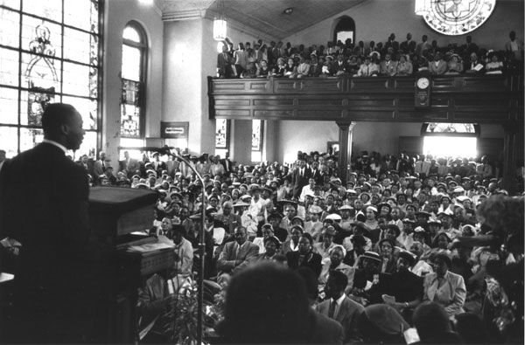
Civil Rights Movement
Black community and infrastructure in which it was embedded provided resources
Black churches, HBCUs, NAACP chapters
Notes:
Black community and institutional infrastructure in which it was embedded

Slide 12
Effects of Externally Derived Resources
External resources ensure functioning of SMO but may come at a cost
Loss of autonomy
Moderation of tactics
Shift in goals
Mediated influence
Co-optation or control
Notes:
Funders could end up calling shots. Movement may maintain some autonomy if funder and movement align: if funder is radical and movement is radical

